Slide 1
Manufacturing Down Time Analysis
Prepared By:
Mostafa Ammar Ghada Gamal
Ahmed Mostafa Abdullah Moghith

Slide 2
Agenda
Project Overview
DataSet
Visualization tool
Cleaning Phase
Dashboard
Key insights
Recommendations

Slide 3
Project Overview
This project is based on the manufacturing downtime dataset, which contains production data from a beverage manufacturing company.
The objective of the analysis is to identify inefficiencies and provide recommendations for improvement based on the available data.

Slide 4
Dataset
The data is in an Excel file with 4 sheets:
Line productivity (Fact table containing details for each batch produced)
Products (Dimension table with details on each product)
Line downtime (Fact table containing downtime (in minutes) by factor for each batch)
Downtime factors (Dimension table with details on each downtime factor)
This Dataset is for only 5 days of production.

Slide 5
Visualization tool
Microsoft Power BI

Slide 6
Data Cleaning
Load the Excel file: "Manufacturing_Line_Productivity"
Inspect data types: Dates, Numbers, Text
Identify missing values
Add new column using DAX to calculate batch production duration.
Unpivoting Line Downtime Table:
In Power Query:
Select downtime columns
Click Unpivot Columns
Converts wide table into attribute-value format.

Slide 7
Data Cleaning(cont.’)
Replacing Nulls After Unpivot
In Power Query:
Select Value column
Replace null with 0
Ensures no missing downtime entries.
Setting Relationships
Link Production Table and Downtime Table
Use common fields: Line or Batch ID
Ensure One-to-Many relationship

Slide 8
Dashboard
Dashboard contains 3 pages :
Overview
Product Analysis
Downtime Analysis

Slide 9
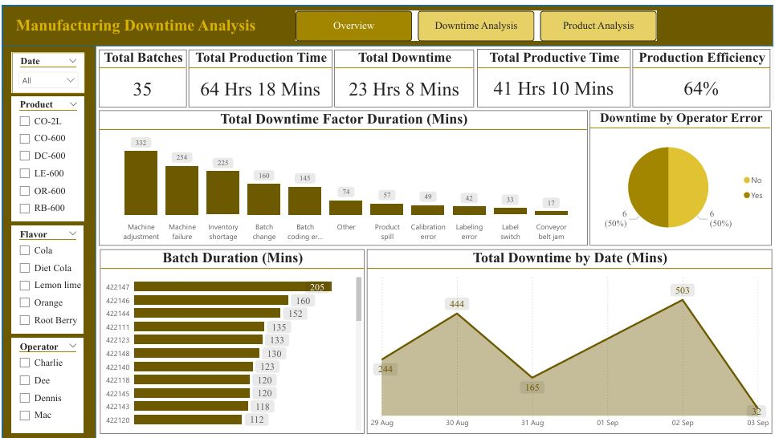
Overview

Slide 10
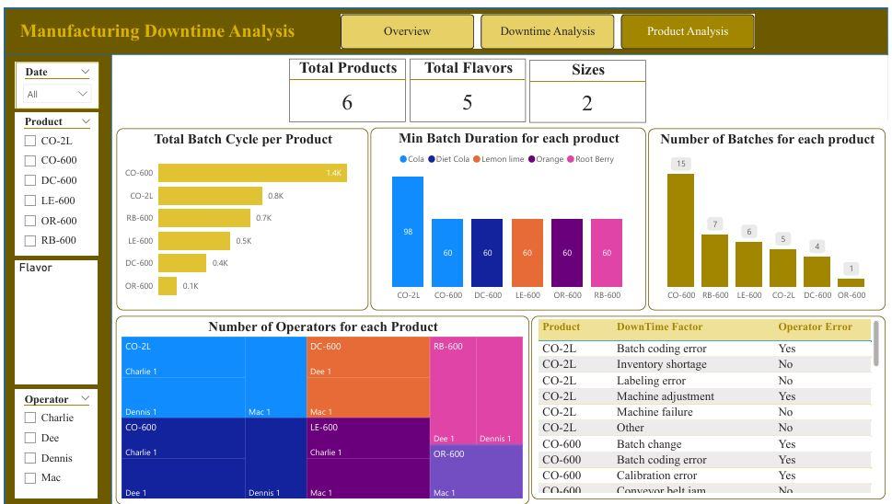
Product Analysis

Slide 11
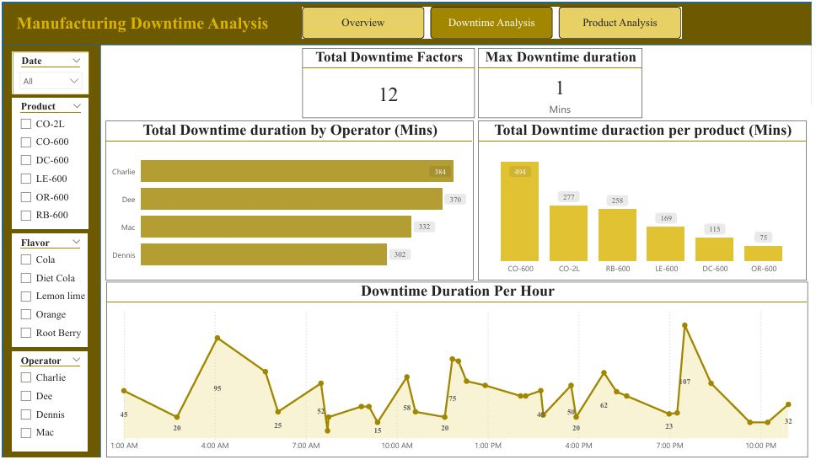
Downtime Analysis

Slide 12
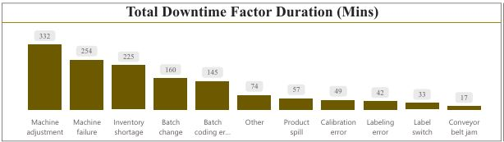
Key Insights
The most downtime is happening because of “Machine Adjustment” Factor.

Slide 13
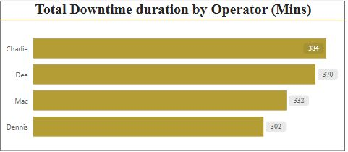
Key Insights
The maximum Downtime duration happened by the operator “ Charlie”.

Slide 14
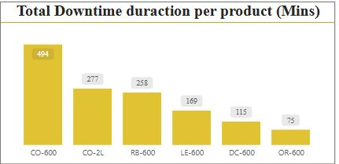
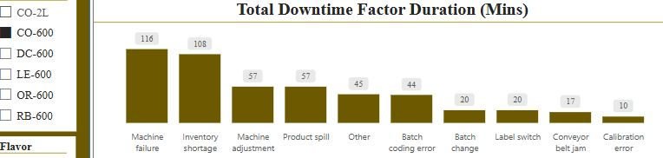
Key Insights
The maximum downtime happed with the product “Cola” size 600 due to the factor of “Machine Failure”.

Slide 15
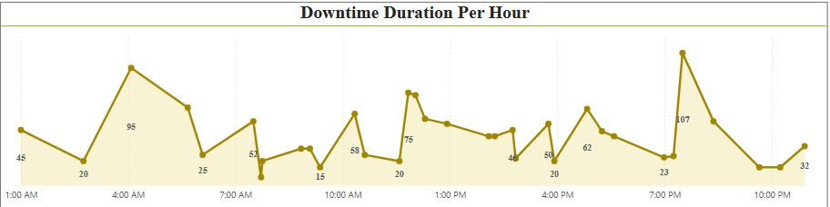
Key Insights
The maximum downtime happed at 7:30 PM.

Slide 16
Recommendations
Machine adjustment training for all operators.
Provides special batch training for Charlie.
Take care of the Maintenance of the machines.

